Slide 1
objects
files
assertFileContains(
“expected.txt”,
person.toString())
assert(2,
names.length)
Files
toString
Automatic
names
assert(“[Tom, Sally]”, names.toString())
verify(person)
diff
tools
long
Strings
assertFileContains(
“expected.txt”,
person.toString())
Files
Expected = “{age:12,
name:Tom,
address: 123 fake st}”
assert(expected,
person.toString())

Slide 2
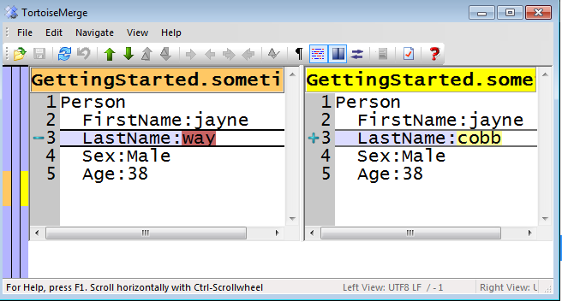
objects
strings
long
strings
files
assert(
“[Tom, Sally]”, names.toString())
Expected =
“{age:12,
name:Tom,
address: 123 fake st}”
assert(2,
names.length)
assertFileContains(
“expected.txt”,
person.toString())
Common Path for Approval Testing
automatic file
names
diff
tools
custom testing
functions
verify(person)
MapReduce.verify(…)
Wpf.verify(…)
Xml.verify(…)
Routing.verify(…)

Slide 3
Common Path for
Approval Testing
patterns for more powerful asserts

Slide 4
1) Numbers
Easy
// verify 2 names
assert(2, names.length)
Simple

Slide 5
1) Numbers
Can get
complicated
// verify names
assert(5, names.length)
assert(“Llew”, names[0])
assert(“Woody”, names[1])
assert(“Jim”, names[2])
assert(“Jason”, names[3])
assert(“Dan”, names[4])
I have to
change my
Scenarios
to make it work

Slide 6
2) Strings
More expressive
Objects, Tests & Logs
// verify names
Assert(
“[Llew, Woody, Jim, Jason, Dan]”,
names.toString())
Can use
your normal
Scenarios

Slide 7
2) Strings
You’ll start to want
more…
// verify names
Assert(
“[Llew, Woody, Jim, Jason, Dan]”,
names.toString())

Slide 8
Long
strings
3)
Easy to test bigger
concepts
// verify json
Assert(
“{age:12,
name:Tom,
address: 123 fake st}”,
tom.toString())

Slide 9
Long
strings
3)
Can get very big
Line endings
// verify xml
Assert(
“<xml><person>\n\t<name>tom<\name>\n\t\<age>\”13\”<\age>\n\t\</person>”,
tom.toString())
Scoping
Matters
can != should

Slide 10
4) Files
Less Clutter
// verify companies as xml
assertFileContains(
“expected.companylist.xml”,
report.toString())
Can use
your normal
Scenarios

Slide 11
4) Files
Lots of filenames
// verify companies as xml
assertFileContains(
“expected.companylist.xml”,
report.toString())
Creating
The files

Slide 12
Automatic
names
5)
Convention over
configuration
// verify companies as xml
Verify(report)
Code starts to become trivial

Slide 13
Automatic
names
5)
What went wrong?
// verify companies as xml
Verify(report)

Slide 14
6) Diff Tools
See the forest
& the trees
(on failure)
Can render html, svg, etc…
Files not limited to text

Slide 15
6) Diff Tools
Duplication
in the tests
(on failure)
On failure event is
pretty basic

Slide 16
Custom Test Methods
7)
Testing gets
easier & easier
MapReduce.verify(…)
Wpf.verify(…)
Xml.verify(…)
Routing.verify(…)
Tests give
high Return on
Investment

